Slide 1


Slide 2


Slide 3
HEALTH CAMPS: AN INSIGHT
These are small duration camps organised in different parts of the country on the basis of health needs of a specific location. These health camps aim at promoting health seeking behaviour in the long term and thus, unlike a general curative health camp, these camps also majorly work on building awareness regarding common ailments, family planning methods, nutrition and hygiene and sanitation. These camps provide comprehensive health services free of any cost.
These health camps are organized with support from corporates, civic bodies, the government, NGOs and individual volunteers. Sankalp has conducted over 5 general health camps till date and has benefitted more than 350 people directly

Slide 4
HEALTH CAMP@ MOHAN NAGAR CENTRE
Sankalp organized a health camp at its Mohan Nagar Centre on 21st Feb 2016
The camp was organized in association with Brahmakumari NGO , Adityapur
Brahmakumari had arranged for the visit of doctors of Government Hospitals whereas medicines distributed to needy children and parents were sponsored by Sankalp
Around 120 children and their parents particularly mothers were given
  Free of cost check up
  Medicines were distributed as per prescription
  Critical health issues of every patient was noted

Slide 5
Health Camp
@
Mohan Nagar Centre
Adityapur

Slide 6


Slide 7
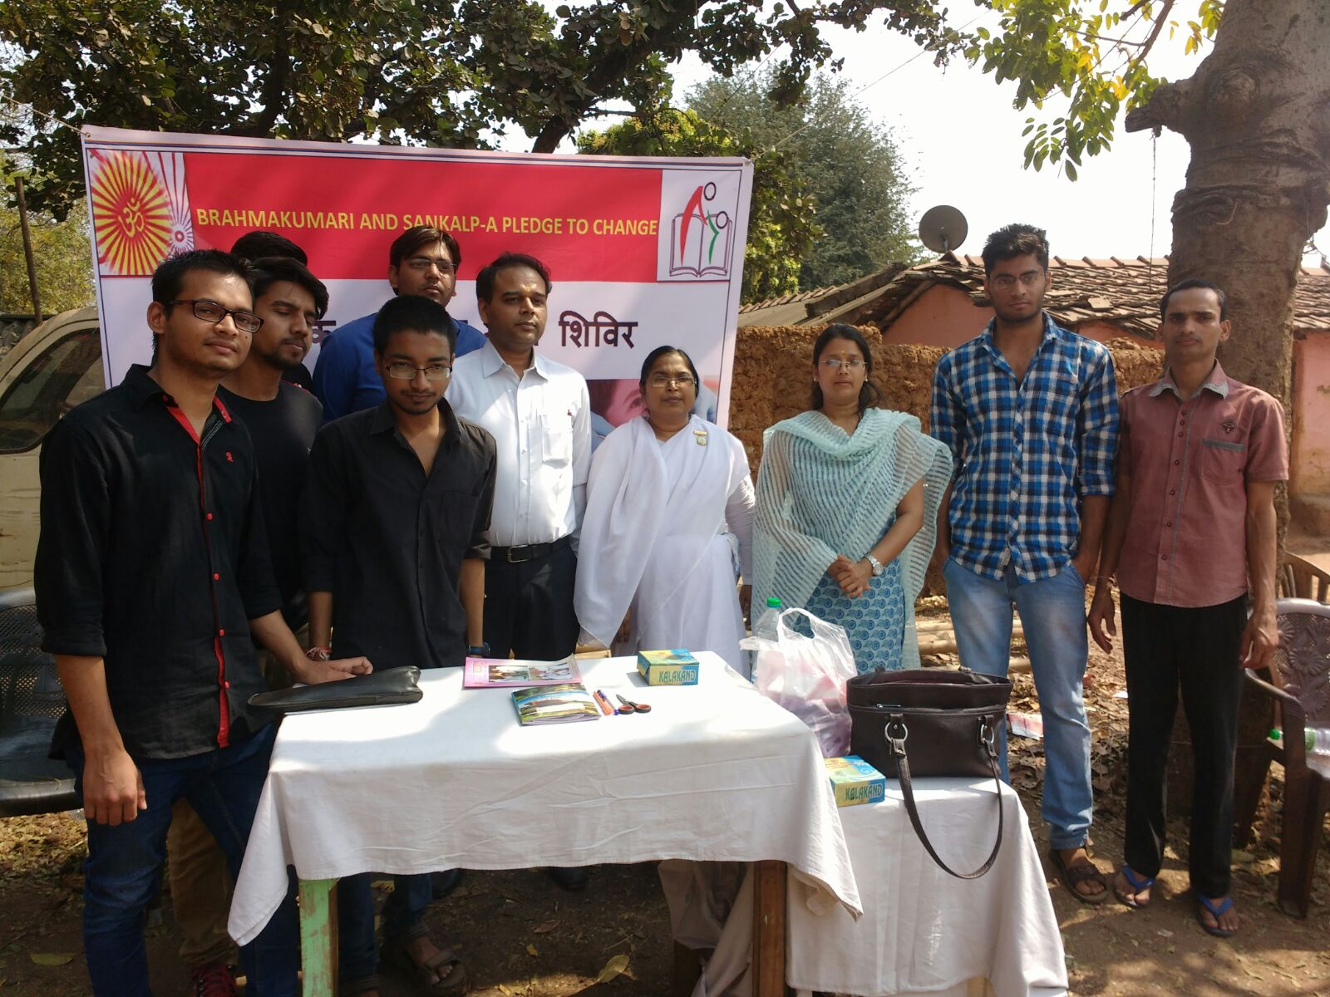

Slide 8
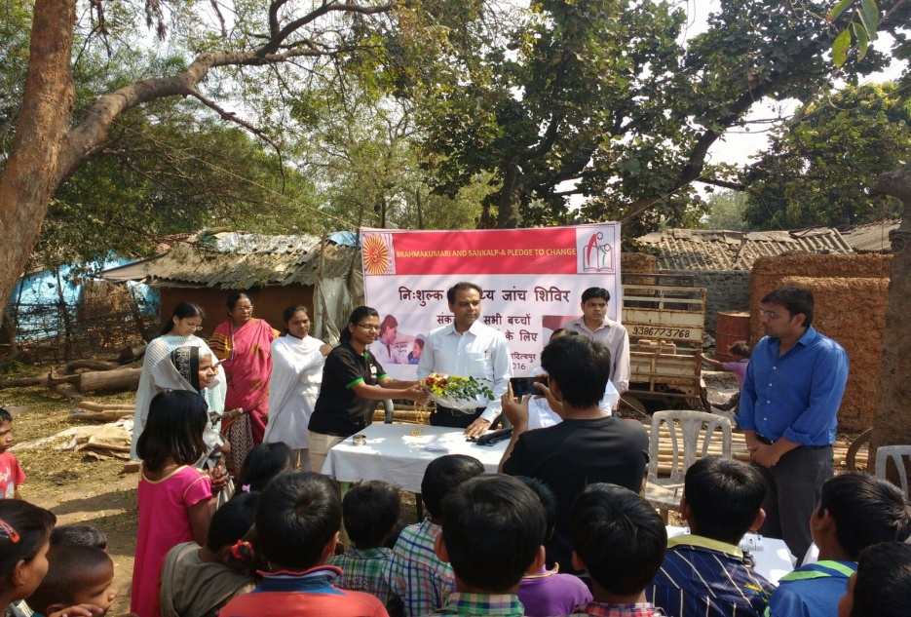
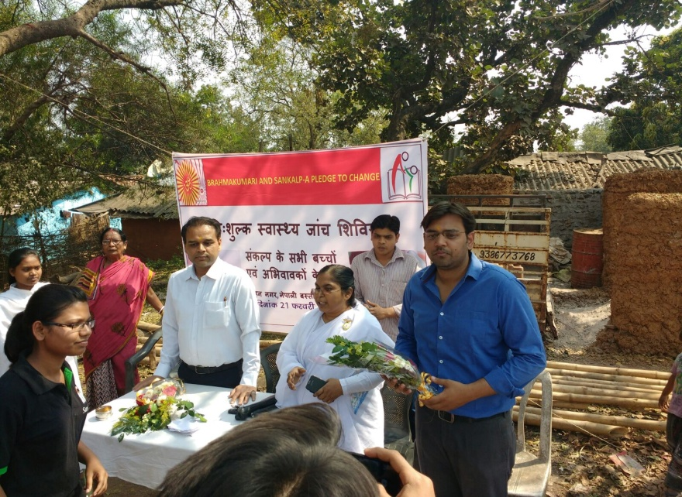
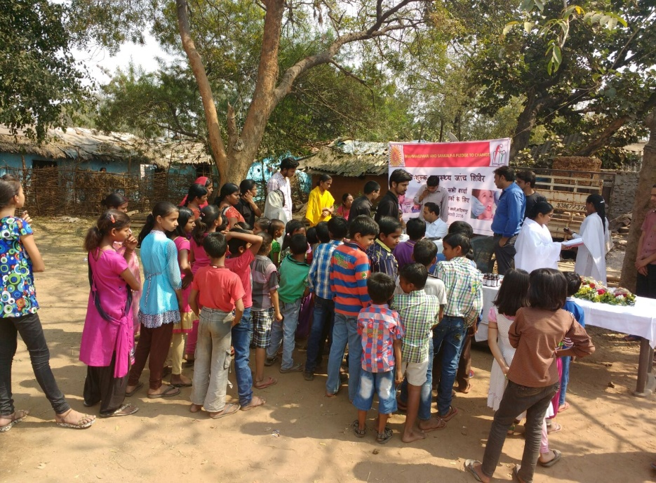
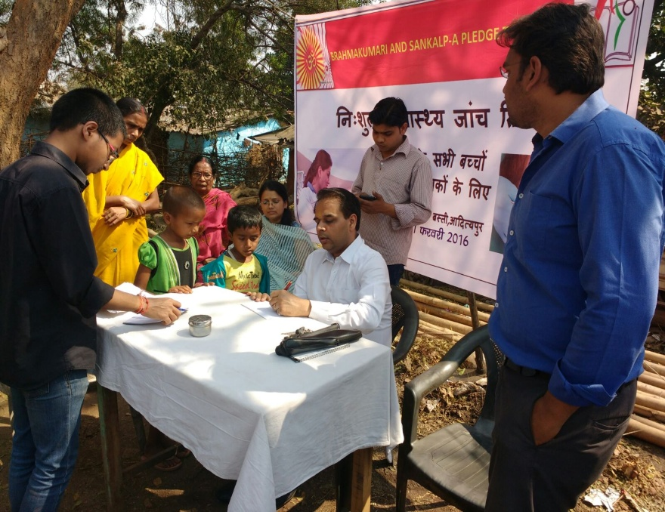

Slide 9


Slide 10
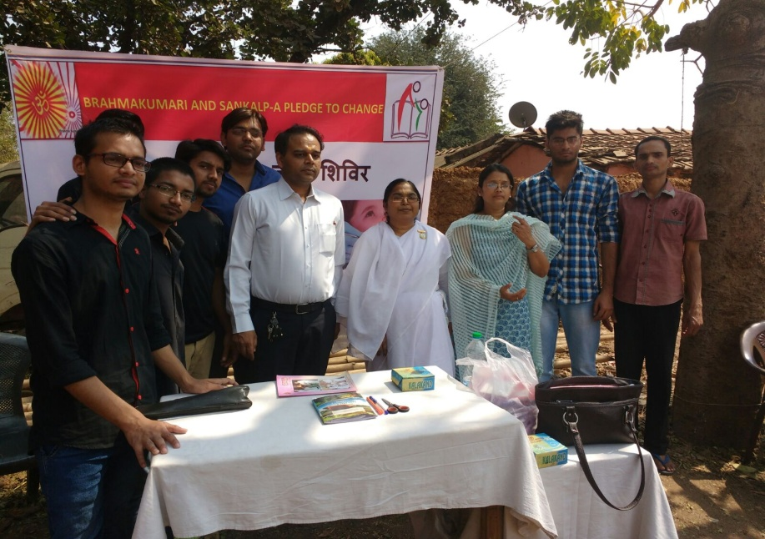
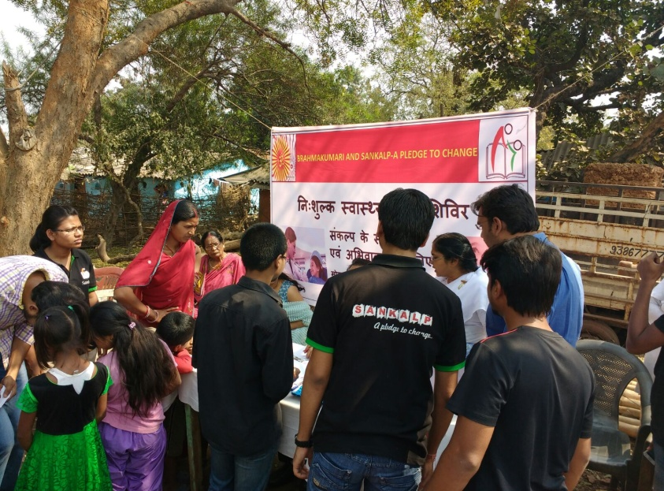
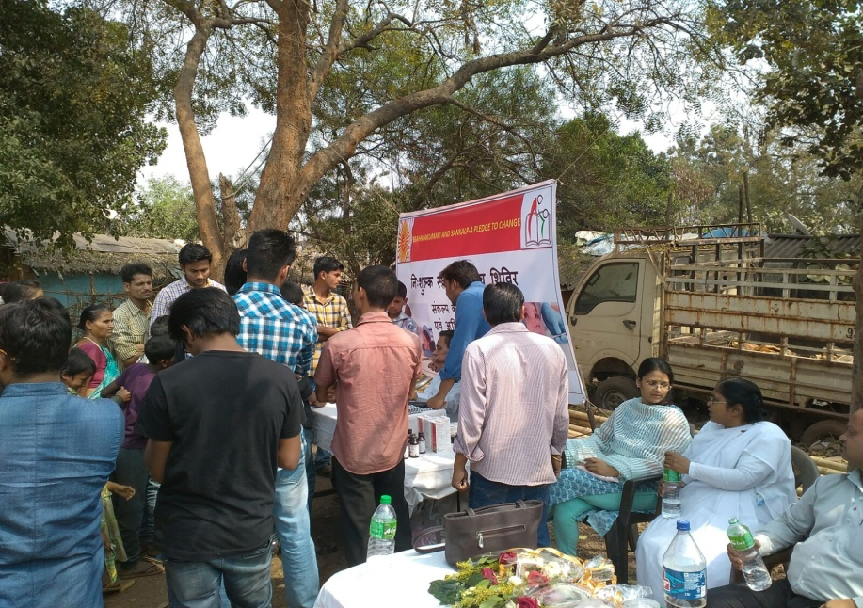
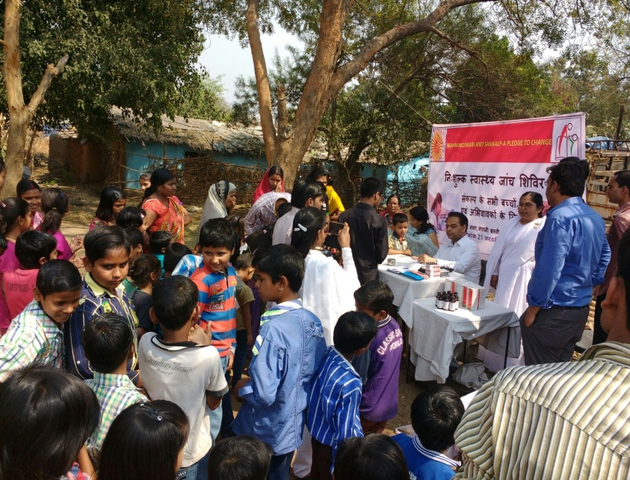

Slide 11

Come let’s be a part of the noble mission called
The Joy of Giving because

Slide 12
EASY WAY TO DONATE NOW
You can donate at any our centres by just making a call to Sankalp-A Pledge to Change volunteers.
All our centres run 6 days a week
You may donate books from
  Class 1-8- Course Text Books (Any Board)
  Story Books
  Unused stationery
  Any other items like bag, toys, uniforms etc.
Relevant Contact Nos. Are
  Subodh Kumar Das-9798756336
  Mayank Aggarwal -9031975746
  Suresh Pareek -7209632032
  Vikas Dixit -9472706225

Slide 13
ACCOUNT DETAILS FOR SUPPORT
Sankalp Account Details
  You can transfer funds online into our account:-
  “SANKALP” A/C No.-31114719936
  CIF No: 85757412911
  IFSC Code: SBIN0001882
  MICR Code: 831002004
  Branch code: (1882)
  Branch: SBI- RIT JAMSHEDPUR
    You may also visit our website and pay through online link available over it.
www.sankalpnitjamshedpur.org

Slide 14
“You have not lived today until you have done something for someone who can never repay you.”
Thank You
www.sankalpnitjamshedpur.org

